Slide 1

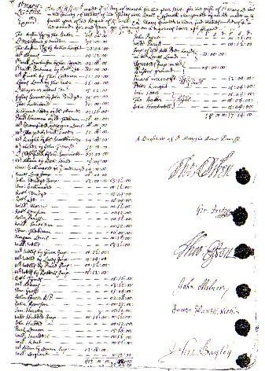
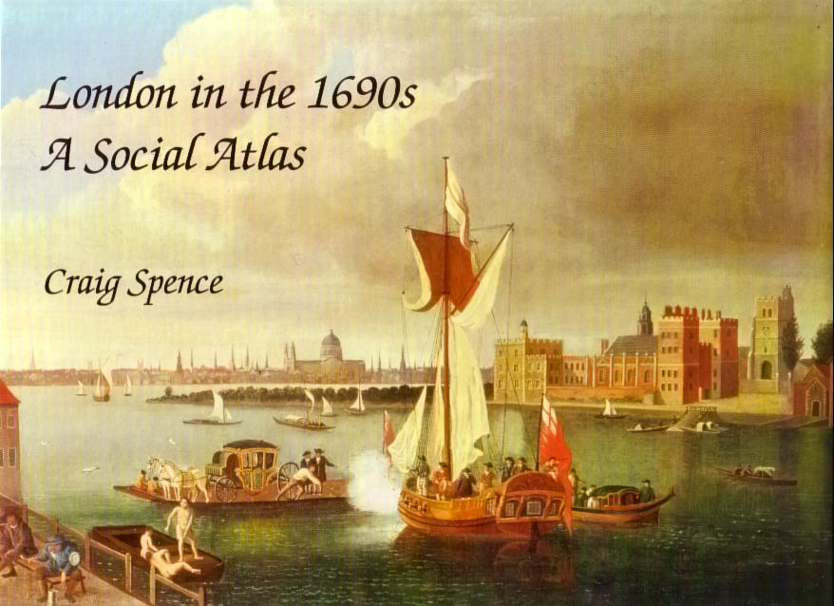
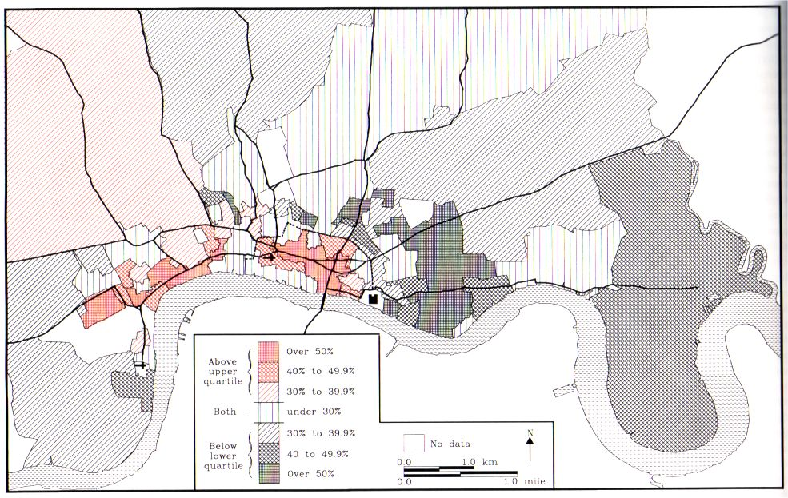



ESRC-Funded ‘Metropolitan London in the 1690s’ Project – CMH/IHR
1690s Taxation Records
1692 Poll Tax (City Only)
1693-4 Four Shilling Aids
craig.spence@bishopg.ac.uk @cgspence

Slide 2
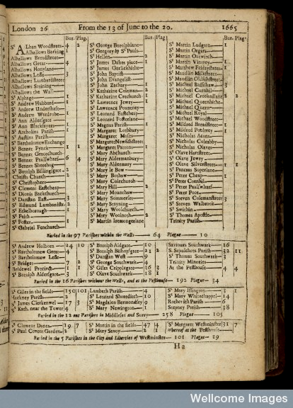
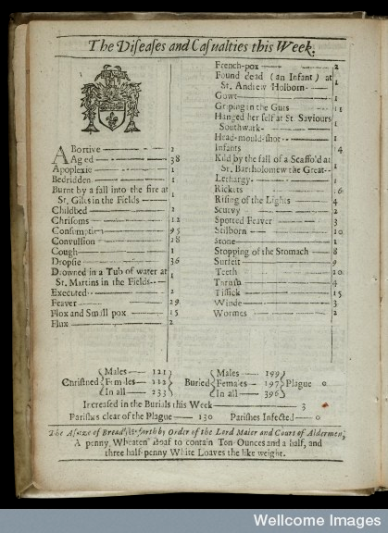
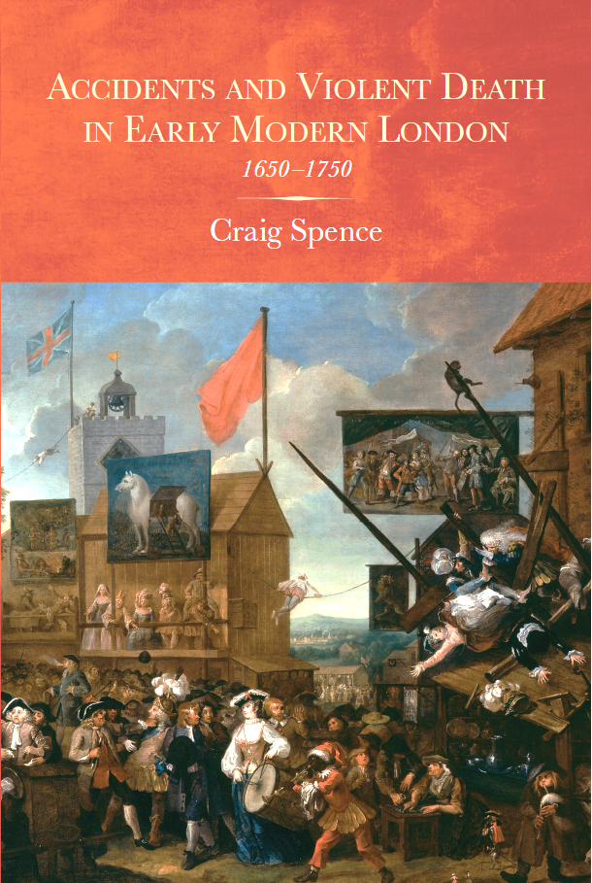

Accidents and Violent death in Early Modern London – 1650-1750
Bills of Mortality Data
‘Casualties’ – 1655-1735 (Accidents/Murders/Suicides)
20 June 1665
28 February 1664
craig.spence@bishopg.ac.uk @cgspence

Slide 3
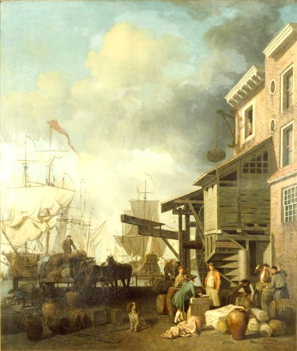
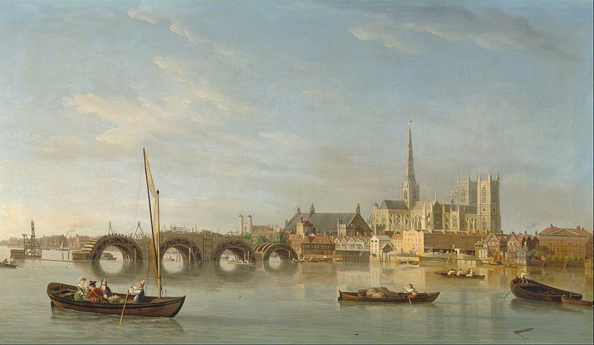
Possibilities…
Location of Riverside Infrastructure (and their sounds)
Ownership/value of Riverside Infrastructure
Location of Drownings
Geography of ‘Casualties’
Seasonal/Annual Patterns & Variations

